Slide 1
CqRs/Flux in xamarin.forms
Patterns for Xamarin.forms application structure

Slide 2
Overview
Original Structure
CQS/CQRS Overview
Flux/Redux Overview
Refactored Structure
Command/Query Organization
Testing
Notes:
Where the app started, everything depends on App

Slide 3
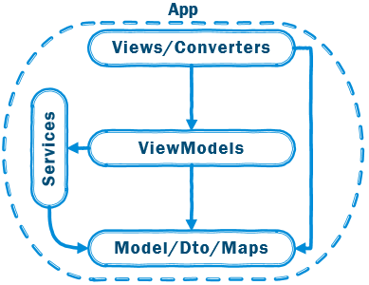
MVVM+S
Model-View-ViewModel + Services
Pros
Separates Views from ViewModels
Services can be testable
Services can group Domain Logic
ViewModels get lighter
Cons
Services are not cohesive
State is managed by many services
State can be mutated by multiple services
Still significant logic in ViewModels
Everything references App
Notes:
Where the app started
All services were static references within App
State was mutable from anywhere within the app
One main service dominated all – DataStoreService basically did everything
State held in a mutable context object that everything mutated

Slide 4
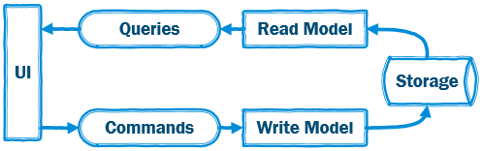
CQrs/CQS
Command Query Responsibility Segregation
Characteristics
Separate Read & Write Models
Eventual Consistency
Improved Cohesion
Improved separation of concerns
Queries – Only read state
Commands – Change state
Flexibility
Notes:
What CQRS is, What it’s not – not talking about ES, Hi-perf, syncing
Command/Query Separation - SRP
Separate Read/Write Models/Paths
Separate Storage
Increased Complexity
Eventual Consistency

Slide 5
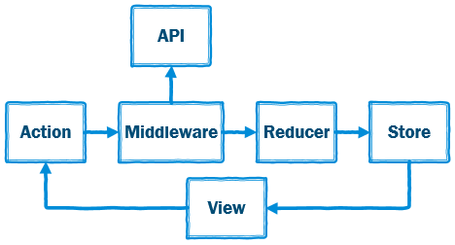
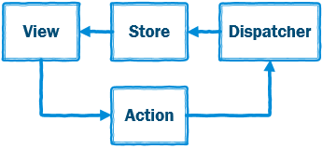
Flux/Redux
Unidirectional data flow
Characteristics
Unidirectional data flow
Changes are easy to follow
State changes are isolated
Redux builds on to Flux
Single source of truth
State is Readonly
Changes are made with pure functions
Notes:
Unidirectional dataflow attempts to make app state predictable
Prevents view from manipulating state directly
Redux builds on Flux and promotes a single source of truth for app state
Additionally app state is readonly and only ever modified by actions
Those actions trigger reducers which are pure functions the modify the app state
Redux also introduces middleware – a kind of interception between actions/dispatcher and reducers
Actions and reducers are sync – async requires async action creators / middleware

Slide 6
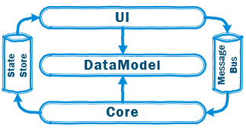
CQRs/Flux –Xamarin.Forms
Major Components
Handlers (Command/Query) + Decorators
Message Bus
State Store
Features
Retains two-way binding at the view
Unidirectional data flow through app
Commands = Reducers/Actions
Queries hit model directly
Notes:
Combining Xamarin.Forms-CQRS-Flux/Redux
Between ViewModel & View standard two data binding – covers general user input, selection etc.
Beyond ViewModel data moves one direction through the message bus into the core logic and back through the state store
All Commands/Queries are async by default – state updates are synchronous but anything that can touch external resources is async

Slide 7
Demo…

Slide 8
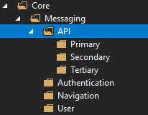
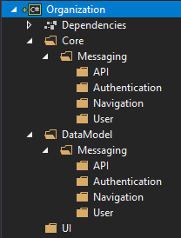
Command/Query Organization
Organiaztion
Hundreds+ Commands/Queries
Entry point messages in Model
Handlers in Core
Secondary/Tertiary messages reside in Core and are not accessed by ViewModels
Notes:
This style of CQRS will produce many small classes – messages and handlers
While all serve a single purpose, without organization it’s just a mess
The main organizational line is between the model & core
The model holds the messages that are used by the ui to initiate some logic
The core holds the handlers that implement that logic
The logic that is initiated by the UI is classified as Primary
Logic that is not initiated by the UI falls under secondary and tertiary groups
Secondary and Tertiary logic is only ever depended on by other core handlers
Also, Logic is grouped similar to how Services are split up – API, Authentication, Navigation etc.

Slide 9
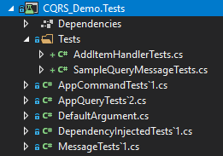
Command/Query Testing
Testing
Every Command/Query needs the same tests
Every Handler needs its dependencies checked
Notes:
Each Command/Query has three tests: Arguments are null checked, Properties are initialized, Default property is present
Handlers inherit from DependencyInjectTests that check all dependencies are null checked

Slide 10
Resources
Code:
https://github.com/ptsteward/CQRS_Demo.git
References:
https://martinfowler.com/bliki/CommandQuerySeparation.html
https://martinfowler.com/bliki/CQRS.html
https://piotrgankiewicz.com/2016/03/15/cqs-an-easy-yet-powerful-pattern/
http://codebetter.com/gregyoung/2009/08/13/command-query-separation/
https://edgecoders.com/the-difference-between-flux-and-redux-71d31b118c1
https://facebook.github.io/flux/
https://redux.js.org/
Notes:
Combining Xamarin.Forms-CQRS-Flux/Redux
Between ViewModel & View standard two data binding – covers general user input, selection etc.
Beyond ViewModel data moves one direction through the message bus into the core logic and back through the state store
All Commands/Queries are async by default – state updates are synchronous but anything that can touch external resources is async

